Slide 1

RGB Image Mosaicing via Multi-graph synchronization
IACV PROJECT
Azzoni Francesco
Fasana Corrado
Pasini Samuele

Slide 2


AGENDA
Introduction
Related work
Proposed approach
Experiments
Conclusions

Slide 3
AGENDA
Introduction
Image mosaicing
Image alignment
Our contributions
Related work
Proposed approach
Experiments
Conclusions

Slide 4
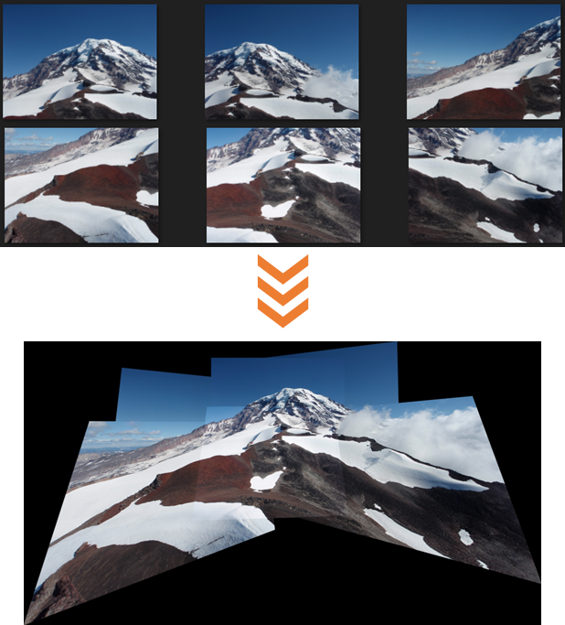
IMAGE MOSAICING
Image mosaicing refers to the problem of aligning/registering multiple images in a bigger one leveraging on homographic transformation.
Two steps are required:
Image alignment: it allows to estimate the transformation that should be applied to the images to obtain the mosaic.
Image compositing: it defines a way to select a final compositing surface and decide how to optimally blend image pixels to minimize unnatural effects such as seams, blur, and ghosting.

Slide 5
Feature Extraction
Use an algorithm to extract features from the images (e.g., SIFT).
IMAGE ALIGNMENT
01
There are several image alignment approaches in the literature. Some of them are based on graph synchronization.
Standard synchronization methods are a way to simultaneously estimate global homographies for all the images, avoiding the fact that the errors accumulate when adding an image at a time to the mosaic.
Feature Matching
Use an algorithm to match the features of pair of images obtaining a set of correspondences (e.g., FLANN).
02
Pairwise homography estimation
Use an algorithm to perform robust homography estimation starting from the identified correspondences (e.g., RANSAC).
03
Global homography estimation
Compute the final transformation to apply to the images to obtain the mosaic, starting from pairwise homographies
04

Slide 6
OUR CONTRIBUTIONs
Our main contributions can be summarized as follow:
We exploit the recent advances in the synchronization problem to implement a multi-graph synchronization-based technique to estimate global homographies for image mosaicing.
We exploit the application of multi-graph synchronization to solve partitioned synchronization problems estimating global homographies for image mosaicing.
We show the effectiveness of the methods comparing them with other methods both qualitatively and quantitatively on different datasets.

Slide 7
AGENDA
Introduction
Related work
Proposed approach
Experiments
Conclusions

Slide 8
RELATED WORK
Schroeder et al. (2011) - proposed four closed-form solutions to the synchronization problem for the specific task of image alignment.
Arrigoni et al. (2020) - group in a survey several methods based on synchronization where the groups have a matrix representation, that allow closed-form solutions.
Dal Cin et al. (2021) - proposed an algorithm (MULTISYNC) for solving the synchronization problem in the case of multi-graphs.

Slide 9
AGENDA
Introduction
Related work
Proposed approach
Theoretical background
Main procedure
Application: partitioned mosaicing
Experiments
Conclusions

Slide 10
THEORETICAL BACKGROuND
A multi-graph is a directed graph with multi-edges
A multi-edge (or multi-arc) is a set of edges having the same source and destination
A group-labeled multi-graph is a multi-graph with a label on every edge (Z)
The multi-graph synchronization is the procedure that, given a group-labeled multi-graph, finds an unknow label for each vertex (X)
X1
Z4
Z3
Z2
X2
Z1

Slide 11
MAIN PROCEDURE
The main procedure of our approach is based on the application of MULTISYNC algorithm to the image mosaicing scenario.
The procedure can be seen as composed of three main steps:
Graph Building
Image Alignment
Image Stitching

Slide 12
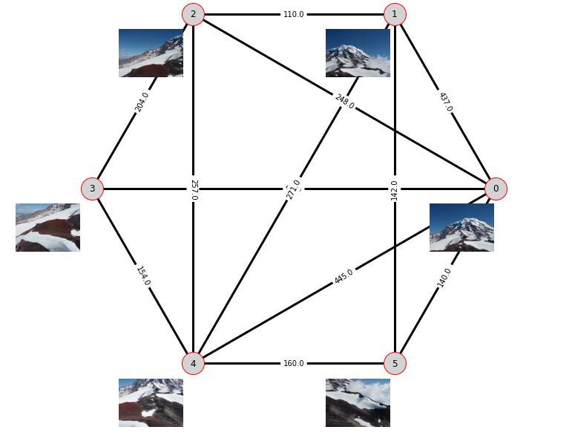
GRAPH BUILDING
The first step of the proposed approach is the graph building.
It is required to obtain the group-labeled multi-graph used by MULTISYNC algorithm.
Every vertex is associated to an image of the dataset, then the features of every images are extracted with SIFT.
To obtain the edge-labelling features are matched with FLANN and the homographies estimated with RANSAC are used as labels.
The multi-graph is then expanded following Dal Cin et al. procedure to reduce to a simple-graph with initial vertices cloned in multiple replicas.

Slide 13
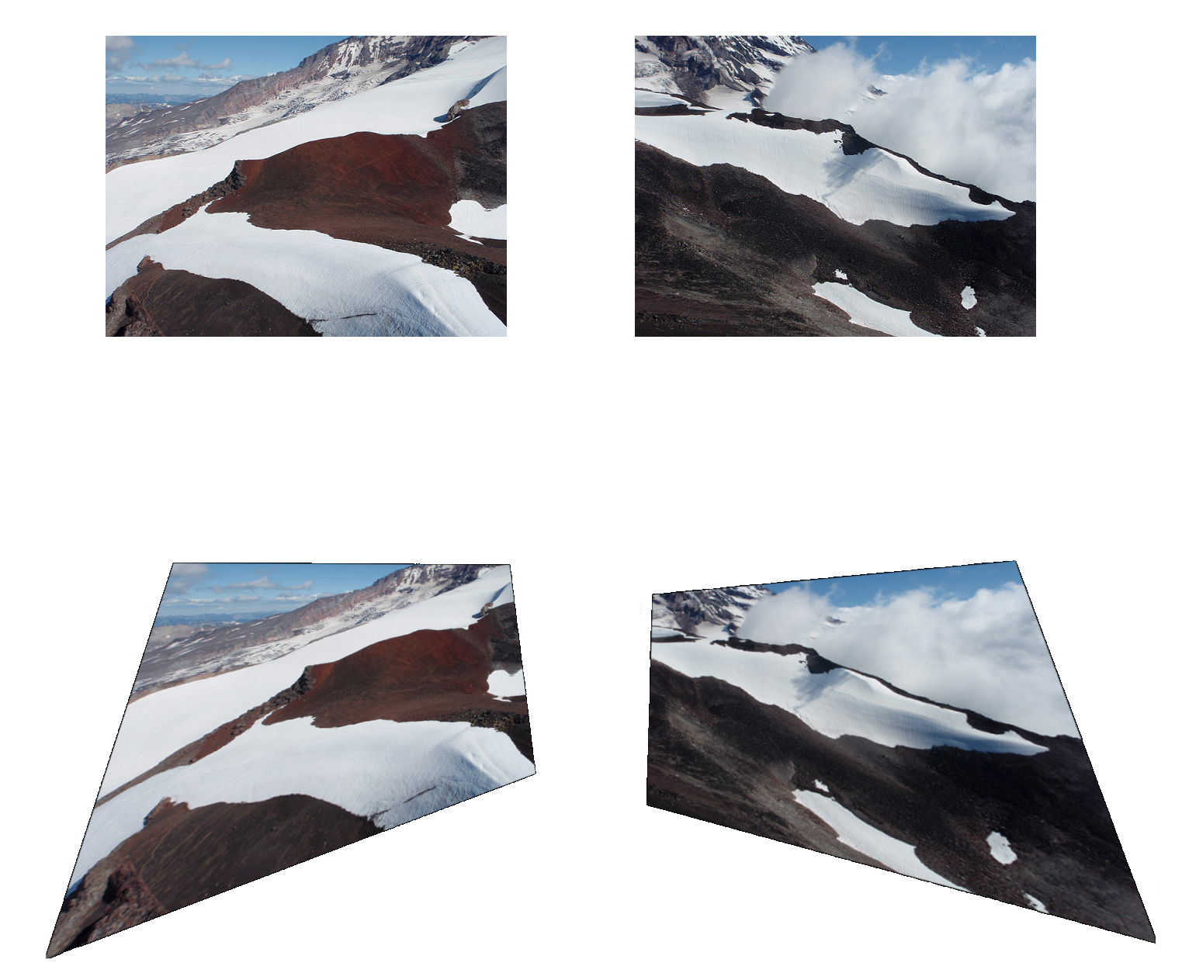

IMAGE ALIGNMENT
Given the expanded graph from the previous step, the MULTISYNC algorithm proceeds with constrained eigenvalues optimization.
The proposed solution is an adapted version of spectral solution with identity constraints between vertex replicas.
At the end of the procedure the unknown vertex labelling is given as output, so the Global Homography Estimation is completed.

Slide 14
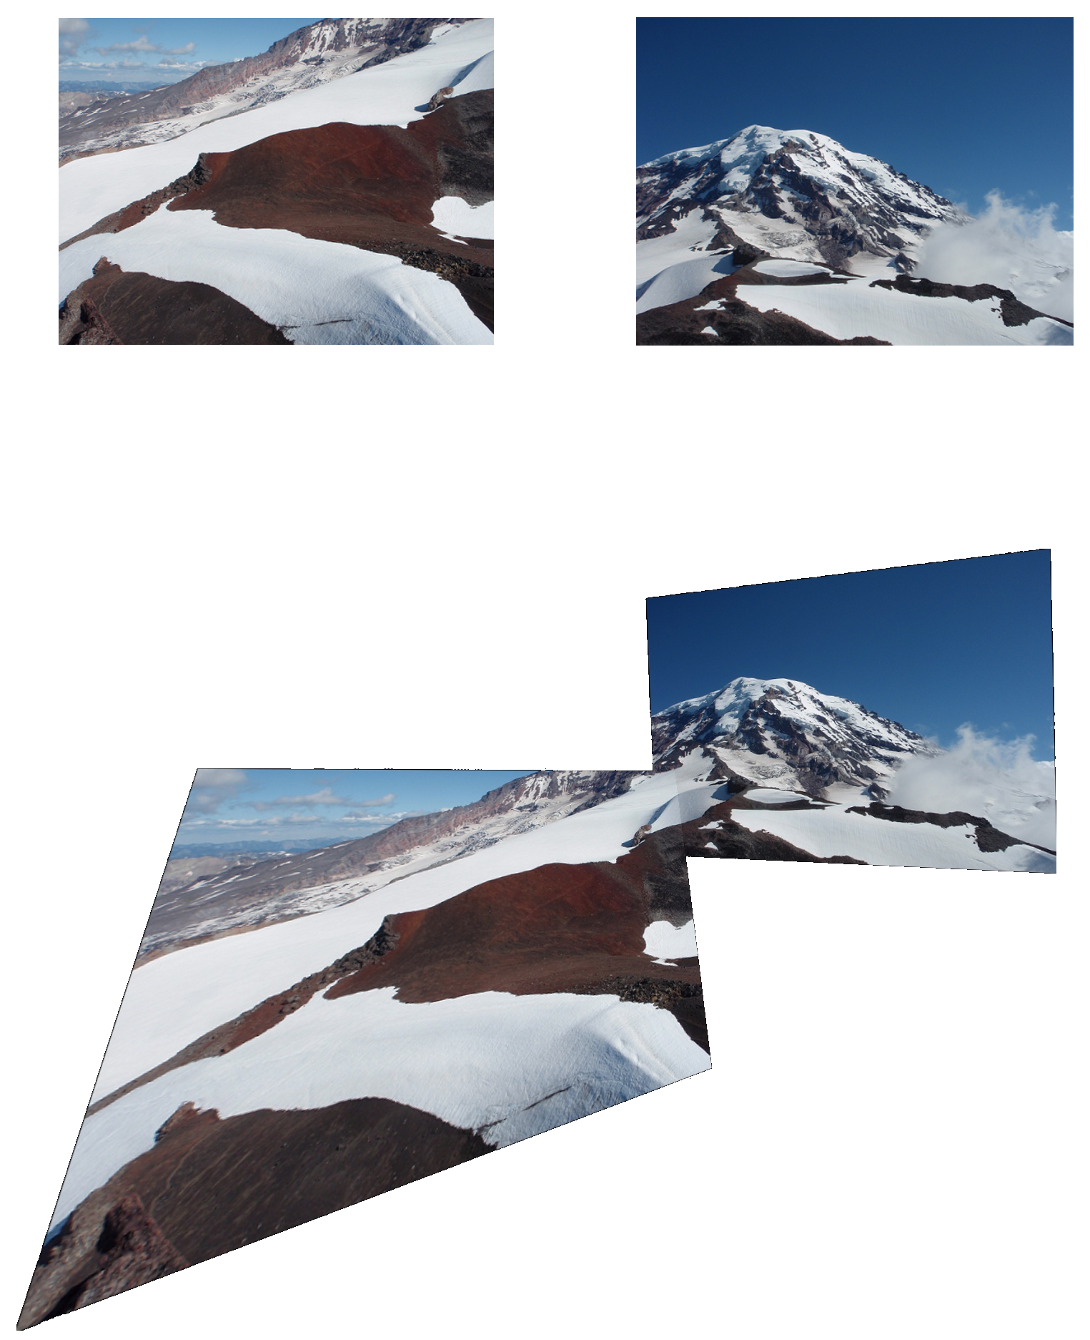
IMAGE STITCHING
Using the global homographies resulting from the image alignment, each image is projected in the reference frame.
Finally, the obtained images are fused into a single wide image using the maximum operator.
Advanced image compositing techniques could be exploited to improve the qualitative result, but this is not the focus of our research.

Slide 15
APPLICATION: PARTITIoNED MOSAICING
Multi-graph formulation can be used to deal with partitioned synchronization problems.
We propose a partitioned mosaicing approach to deal with a large amount of images.
The main steps are:
Graph partitioning: the graph vertices are partitioned into several clusters
Patch synchronization: each obtained cluster is synchronized using the spectral solution
Patch-graph building: a new graph is constructed based on the results of the previous step
Patch-graph synchronization: multi-graph synchronization is applied to the patch-graph

Slide 16
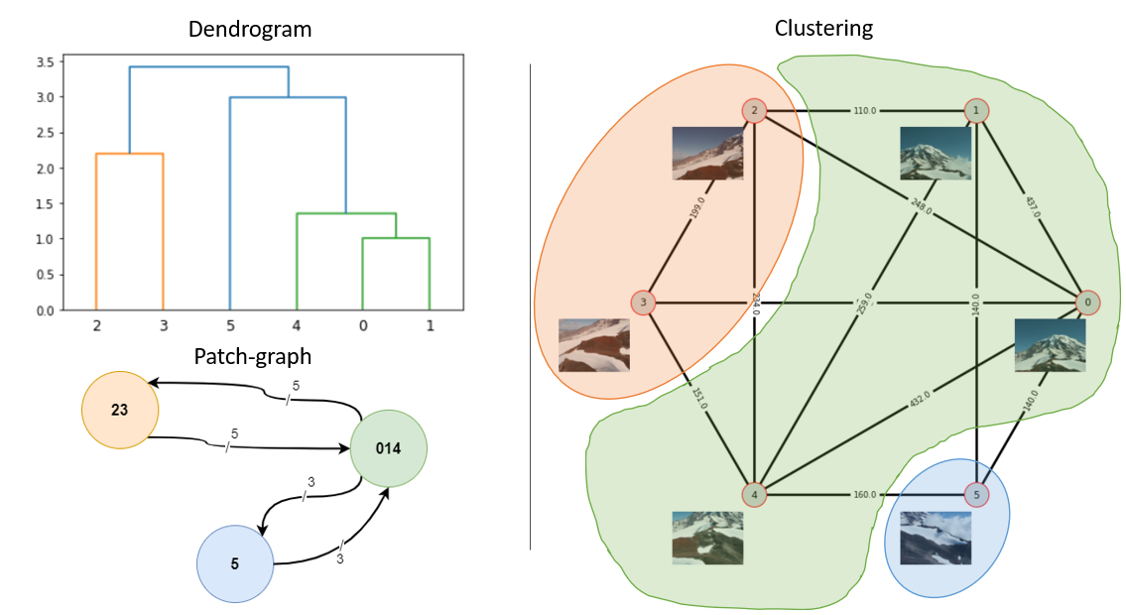
APPLICATION: PARTITIoNED MOSAICING

Slide 17
AGENDA
Introduction
Related work
Proposed approach
Experiments
Methods
Datasets
Setup
Results
Conclusions

Slide 18
METHODS
Several methods are implemented to compare the results:
Basic Stitching: one global homography at the time is computed combining pairwise homographies
Simple-graph stitching: spectral solution is applied to estimate the global homographies
Edge-averaging stitching: the multi-graph is built but, instead of expanding it, it is reduced to a simple-graph taking as label for every multi-edge the average of the homographies
Multi-graph stitching: our proposed method
Multi-patch stitching: our proposed method for partitioned mosaicing
Multi-patch edge-averaging stitching: our proposed method for partitioned mosaicing applying edge-averaging instead of multi-graph synchronization to the patch-graph

Slide 19
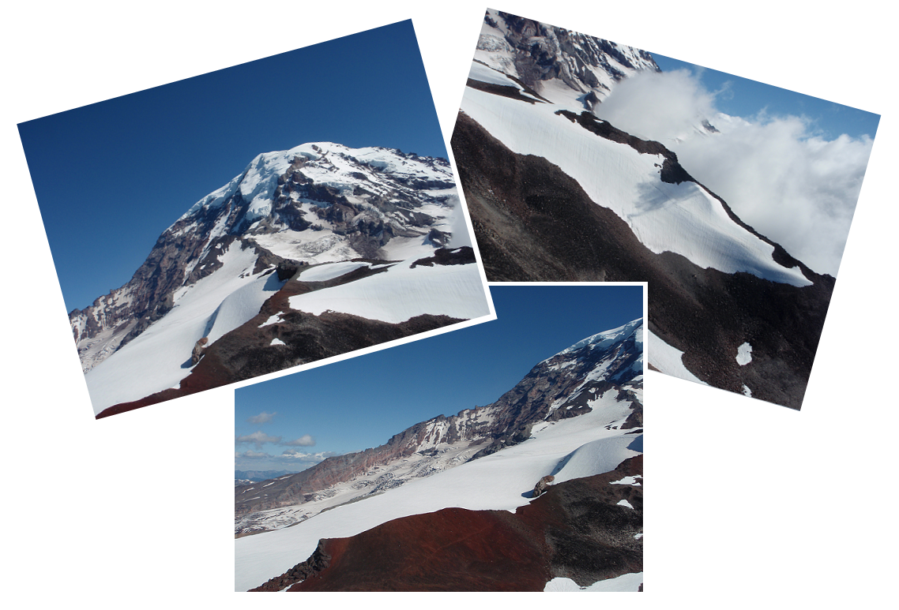
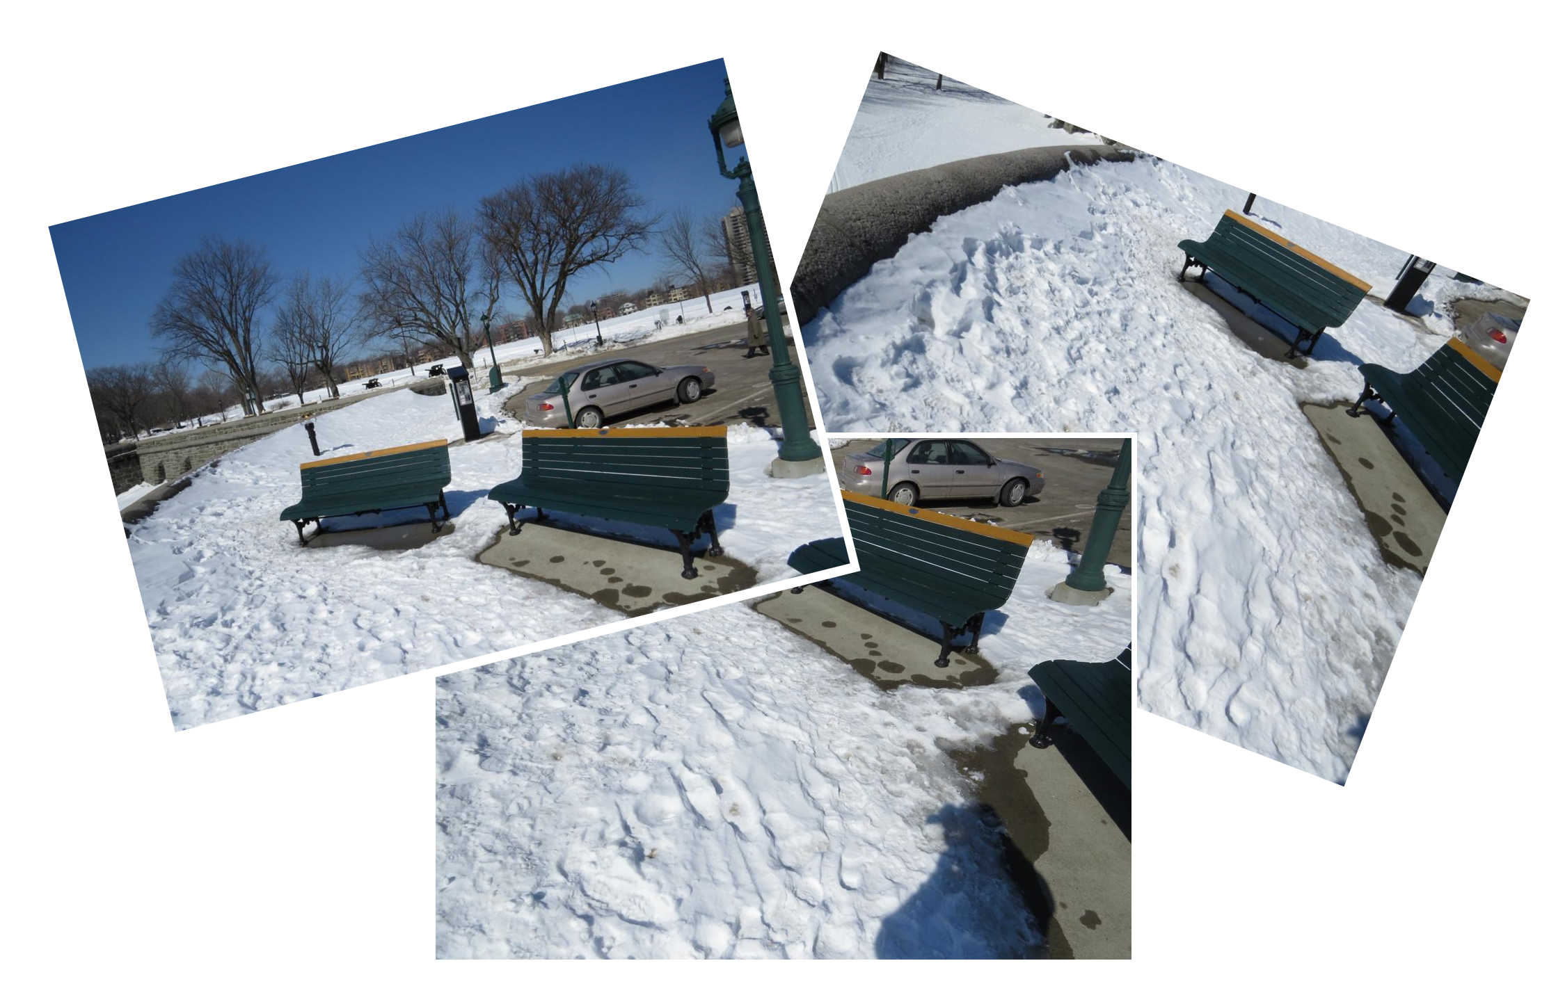
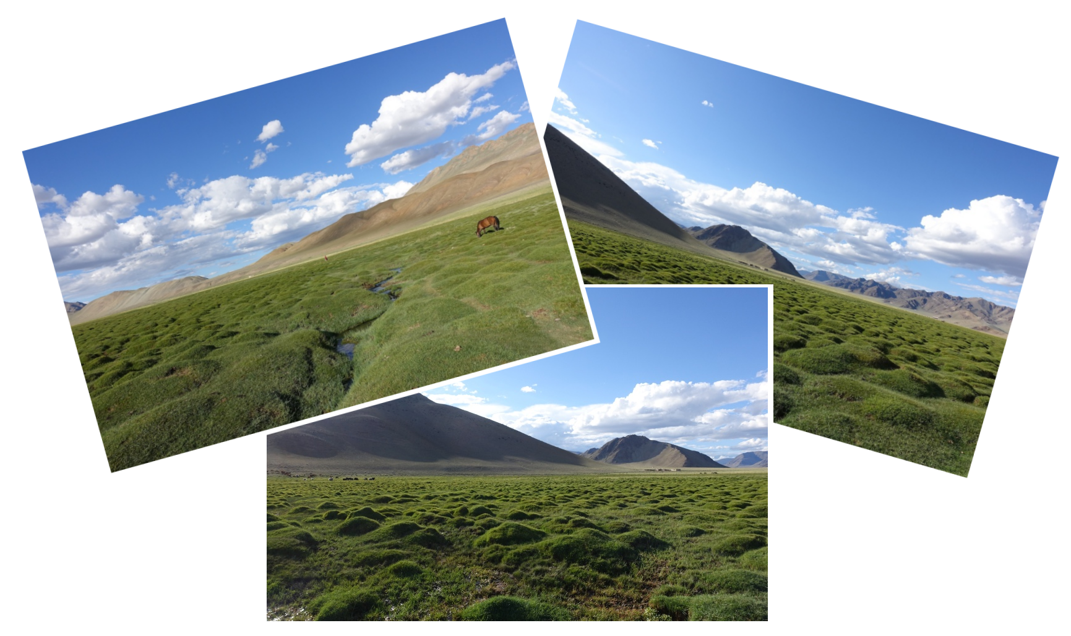
DATASETS
Several datasets have been used to test our methods.
Each of them is composed of a set of images taken from the same camera rotating around the camera centre.

Slide 20
SETUP
Given the absence of ground truth to evaluate the correctness and goodness of the applied methods, we decided to implement a procedure that allows the creation of noisy images.
Resulting global homographies are compared with those obtained by applying simple-graph synchronization in a noise-free scenario, considered as ground truth.
The error is defined as the Frobenius norm of the deviation from the identity.
The experiments have been conducted on different datasets several times, changing the noise standard deviation and the multi-edge degree.

Slide 21
RESULTS
Method | Sun | Snow | Pognana | Mountain
Basic | Ok (slightly better than Edge-Averaging Patch) | Worst | Worst | Ok (slightly better than Edge-Averaging Patch)
Simple-Graph | Bad (slightly better than Multi-Patch) | Ok | Ok | Worst
Edge-Averaging | Best | Best | Best | Best
Multi-Graph | Best | Best | Best | Best
Multi-Patch | Worst | Ok (slightly better than Simple Graph) | Ok (slightly better than Simple Graph) | Ok
Edge-Averaging Patch | Ok | Ok (same as Multi-Patch) | Ok (same as Multi-Patch) | Ok (slightly better than Multi-Patch)

Slide 22
AGENDA
Introduction
Related work
Proposed approach
Experiments
Conclusions
To summarize
Further research
References

Slide 23
TO SUMMARIZE
The results show the effectiveness of MULTISYNC applied to a real image mosaicing scenario, being very robust in particular in presence of noise and showing superiority w.r.t. other approaches.
The results show also similar performances for the naive approach based on edge-averaging
MULTISYNC does not seem very effective in partitioned mosaicing

Slide 24
FURTHER RESEARCH
Investigating the relationship between the results obtained with Multi-Graph stitching and Edge-Averaging stitching
Investigating the relationship between the results obtained with Multi-patch stitching and Multi-patch Edge-Averaging stitching
Considering the introduction of multi-arcs in patch synchronization for partition mosaicing, using MULTISYNC for each cluster
Collecting more challenging datasets to evaluate the performances of multi-graph based methods on real data introducing a ground truth

Slide 25
REFERENCES
It is possible to find the implementation and the paper about our work at:
https://github.com/fasana-corrado/RGB-Mosaicing-via-Multigraph-Synchronization
Main references are:
2011 - Schroeder et al. – Closed form solutions to multiple-view homography estimation
2020 - Arrigoni and Fusiello - Synchronization problems incomputer vision with closed-form solutions
2021 - Dal Cin et al. - Synchronization of group-labelled multi-graphs
The complete references are reported in the paper.

Slide 26
THANK You FOR THE ATTENTIoN
Azzoni Francesco
Fasana Corrado
Pasini Samuele

